Slide 1
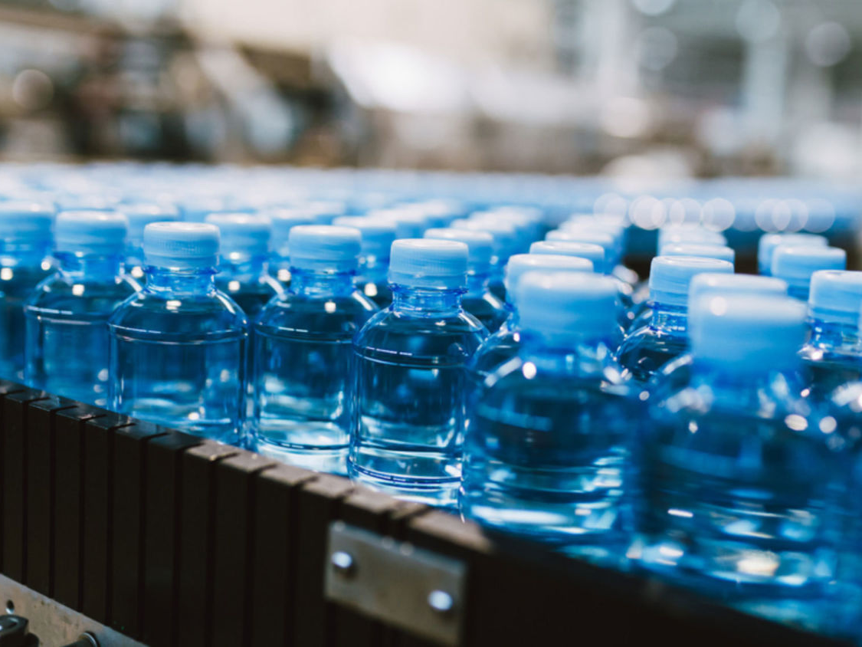
Nat5 Design & Manufacture
Plastic Manufacturing

Slide 2
Learning intentions & success criteria
Learning Intentions
Develop an understanding of plastic manufacturing processes.
Investigate existing plastic products to determine the process used to make them.
Success Criteria
I can analyse a product and identify the manufacturing processes used to make it.
I can name the steps for each manufacturing process.

Slide 3
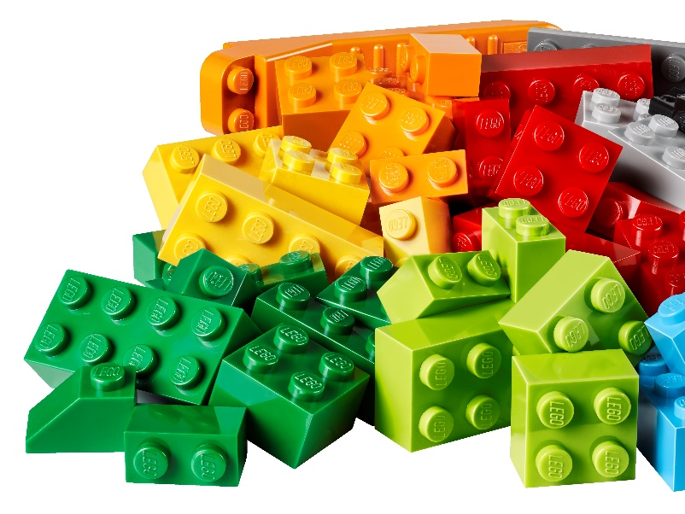
Starter task plastics recap
Which raw materials are used to manufacture plastic?

Slide 4
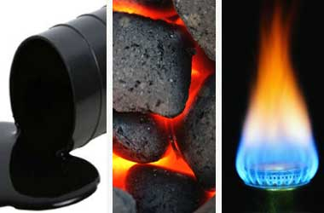
Starter task plastics recap
ANSWER:
Oil, Coal and Natural Gas
Some plastics are from other non-fossil fuel sources such as;
Plants (cellulose)
Trees (latex, amber, resin)
Animals (horn, milk)
Insects (shellac)

Slide 5
Starter task plastics recap
What are the two main groups that plastics are classified as?

Slide 6
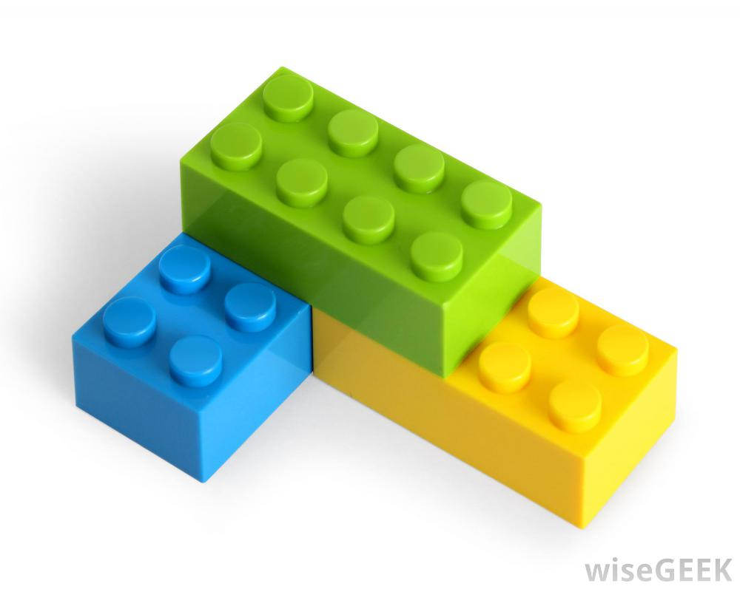
Starter task plastics recap
ANSWER:
Thermoplastics
Thermosetting plastics

Slide 7
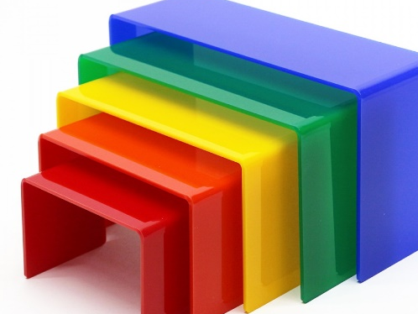
Starter task plastics recap
Name the general properties of plastics.

Slide 8
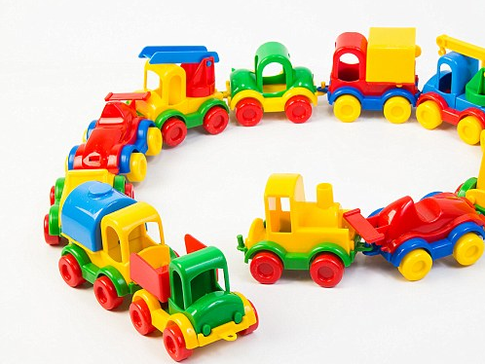
Starter task plastics recap
ANSWERS:
Lightweight
Strong
Inexpensive
Resistance to Corrosion
Resistance to Electricity
Easily Formed/versatile
Recyclable
Available in a Variety of Colours
Easily cleaned or maintained
Durable
Odourless

Slide 9
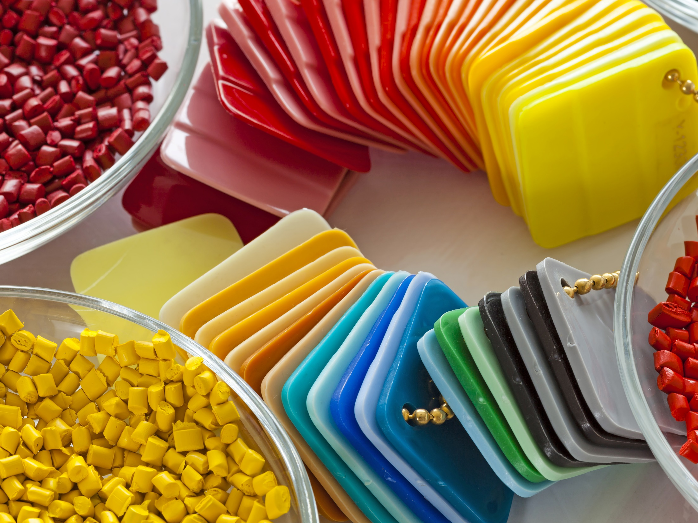
Starter task plastics recap
What are some disadvantages of plastic?

Slide 10
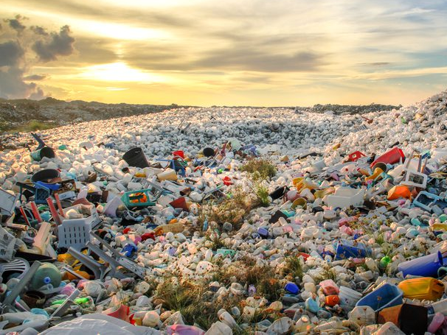
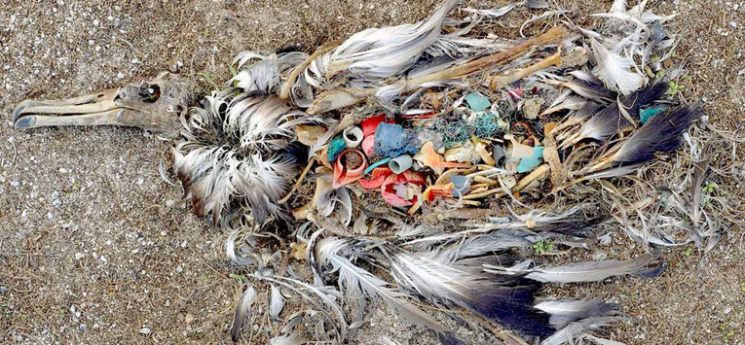
Starter task plastics recap
ANSWERS:
Environmental Damage
Pollution
Danger to animals
Everlasting landfills (thousands of years)
Break down into microplastics
Chemical Risk
Harmful to humans/animals
Affects metabolism, cancers and other diseases.

Slide 11
decomposition times
Plastic bottles: 70-450 years
Plastic bag: 500-1000 years
Tin can: around 50 years
Leather shoes: 25-40 years
Thread: 3-4 months
Cotton: 1-5 months
Rope: 3-14 months
Cigarette: 1-12 years
Milk packet (tetra) covers and drink packets: 5 years
Nylon clothes: 30-40 years
Sanitary napkins & children diapers: 500-800 years
Glass bottles: 1,000,000+ years
Hairspray bottle: 200-500 years
Fishing line: 600 years.
Glass bottle: 1-2 million years
Aluminium can: 200 years

Slide 12
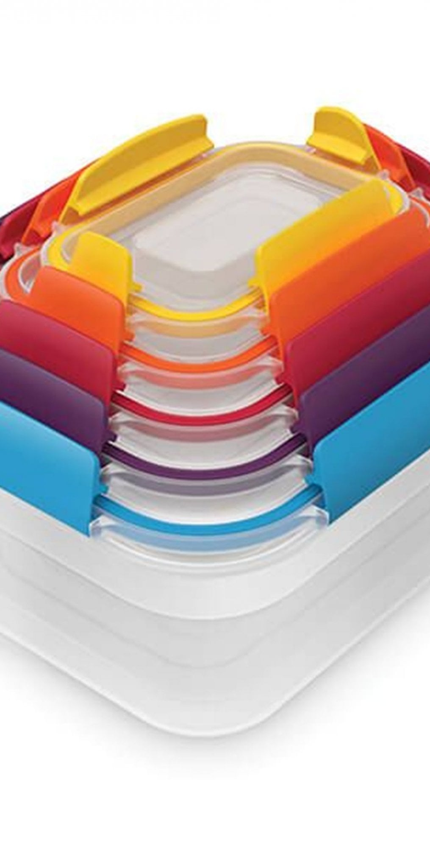
Manufacturing processes
To be a success in the marketplace products must have certain attributes:
The product must function as intended.
The product must look good.
The product must be cost effective.
The product is able to be manufactured.
All members of the design team will be aware of the cost and the process chosen to manufacture the product.
This means that it will be cost effective and any necessary changes to the design or manufacture of a product can be made early on.

Slide 13
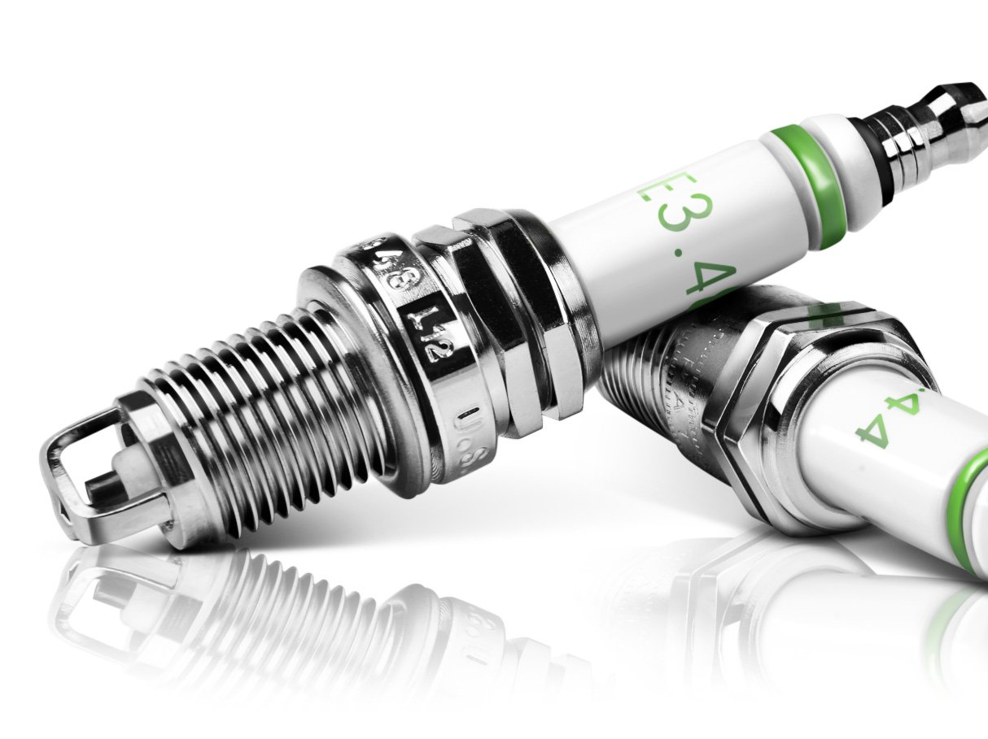
standardisation
Components, materials and production procedures all have to be costed prior to beginning manufacture.
Standardisation of these things will cut down on costs and can then be applied to more than one product at a time.
A car is a good example of this, some parts can be used across a range of cars
e.g. VW, Audi, Seat and Skoda all share
parts with various models.
Other examples include nuts, bolts, screws, washers and more.

Slide 14
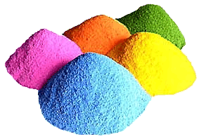
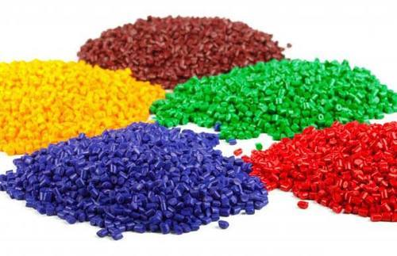
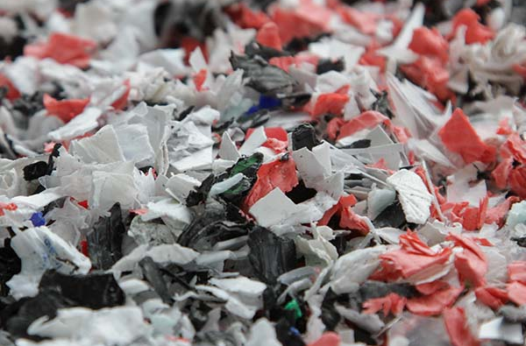
Manufacturing processes
Plastics are usually supplied as moulding powder, granules or chips which have to be processed.
Processing includes the thorough mixing of additives to allow a relatively small base of plastics to be transformed into a wide range or versatile materials.

Slide 15
Manufacturing processes
We will be looking at 4 different processes for plastic manufacture:
Bending and Twisting
Injection Moulding
Vacuum Forming
Rotational Moulding

Slide 16
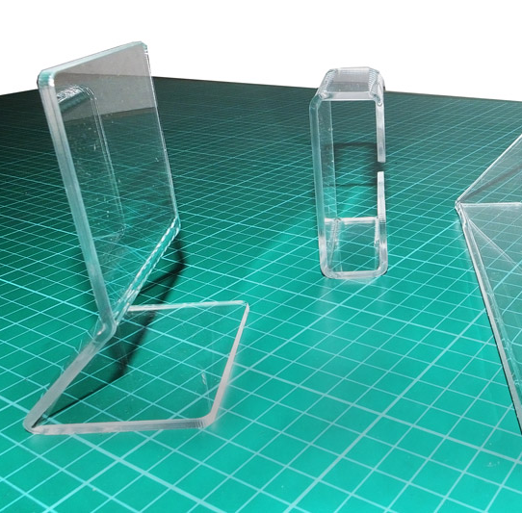
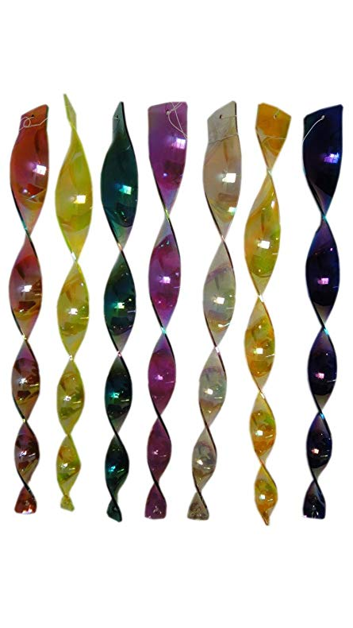
Bending and twisting
When acrylic is heated to 150°C, it becomes soft and flexible.
This allows it to be easily bent or twisted into a new shape.
Upon cooling to room temperature, it retains this new shape.
There are two main ways to heat acrylic;
Strip Heater
Oven

Slide 17
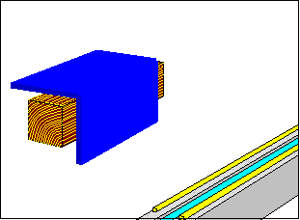
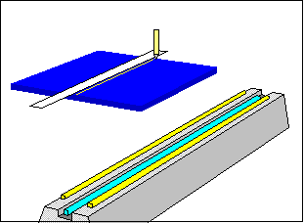
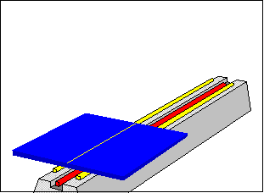
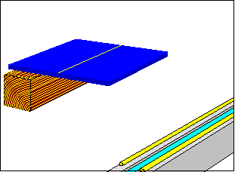
Bending and twisting strip heater
Only heats a narrow strip of the acrylic to allow local bending
Once heated, it can be bent on a former or a jig.
Stage 1 The first stage is to mark the line where the bending will take place
Stage 2
The second stage is to place the acrylic over the heating element, turning regularly to avoid burning.
Stage 3 The third stage is to remove the soft heated acrylic and place it on a suitable JIG or FORMER.
Stage 4 The last stage is to bend the acrylic to the desired shape.

Slide 18
Bending and twisting oven
For more complex shapes.
For 3mm thick acrylic the oven should be set to a maximum of 170°C and heated for 15-20 minutes before forming the shape required.

Slide 19
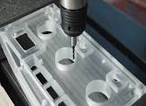
Hazards of bending, twisting and drilling plastic
Plastic is a brittle material. When working with plastic ensure that you do your best to stop it cracking, splitting or breaking.
Always make sure the plastic is heated to a malleable level before bending or twisting.
When drilling ensure that your sheet plastic is flat on a surface, clamped securely and unable to bend. This will mean that the chance of it cracking, breaking or chipping is less likely.
Set the drill to the correct speed setting (RPM).
Drill slowly through your material.
Make sure your drill is perpendicular to the material.
Keep the drill running as you remove it from the material.

Slide 20
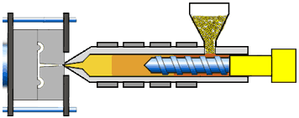
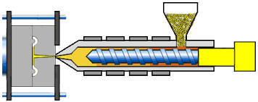
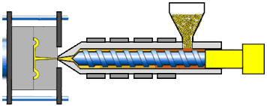
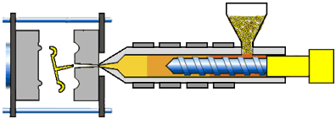
Injection moulding
hopper
heater
Mould
Hydraulic system
Injection moulding allows for a large quantity of components to be made rapidly.
Step 1: Thermoplastic granules are heated until they soften
Step 2: The material is forced into a mould under high pressure
Step 3: When cooled, the mould is opened and the newly-formed component is removed.
Mould

Slide 21
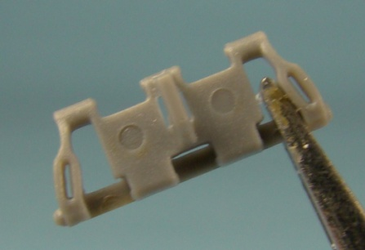
Injection moulding
Examples of injection-moulded plastic:
Golf tees
Spoons
Wash Basins
Buckets
Airfix Models
Product Casings
Identifying Features
A way of telling if a product has been injection moulded is to look for ejection pin marks on the surface of the product. These are normally circular marks left when the pins force the product out of the mould.

Slide 22
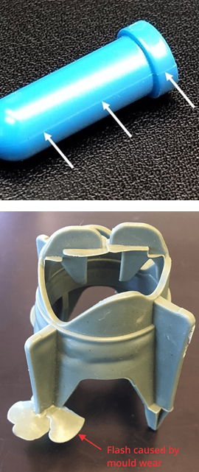
Injection moulding
IDENTIFYING FEATURES:
•Rounded indents where the plastic has been pushed out of the mould.
•Tapered edges
•Complex Shapes are more likely to be injection moulded
•Mould split lines as the mould is in two separate parts
•Flashes
•Webs
•The object is one single part

Slide 23
https://www.youtube.com/watch?v=C3oiy9eekzk (1min 34secs)

Slide 24
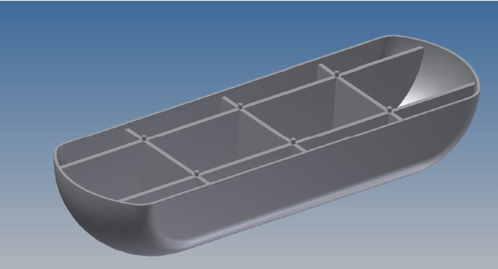
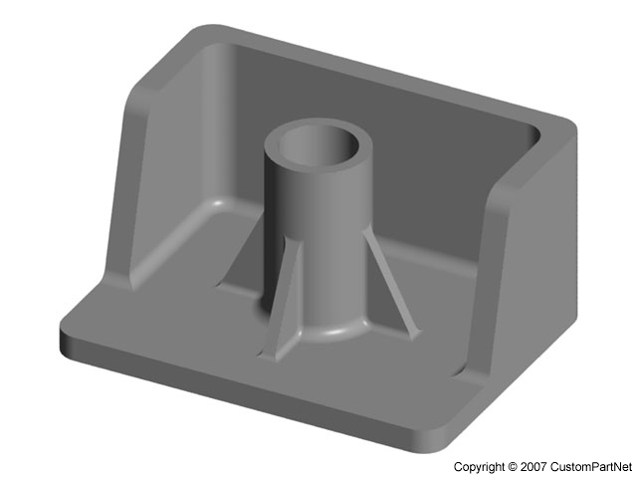
Injection moulding
Wall Thicknesses
Thick walls use large amounts of plastic take longer to cool
Reducing wall thickness to minimum amount required for strength reduces the amount of plastic and speeds up the process
Ribs can give rigidity and strength to thin walls
Bosses (a common feature in housings where components are screwed together) can have their wall thicknesses reduced using webs.

Slide 25
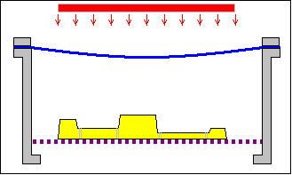
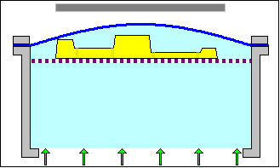
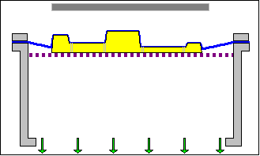
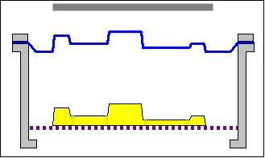
Vacuum forming
Step 1: A sheet of thermoplastic is held in a clamp and is heated until it is soft and flexible.
Step 2: The platform containing the mould is then raised up to meet the sheet of softened plastic.
Step 3: Air is then sucked from underneath the sheet in order for the air pressure to pull the sheet down onto the mould.
Step 4: The mould pattern is removed and the cooled, solidified plastic is left in the end.
Vacuum moulding allows for complicated shapes to be formed.
platform raised
air sucked out
formed plastic

Slide 26
Vacuum forming
Identifying Features
In Vacuum forming, the shape of the product is important because:
Rounded Corners: sharp edges may cause the plastic to rip or tear.
Tapered Edges: sloping sides so that it can be easily removed from the mould.
Internal Curves: should not be included as they cause folds in the plastic to occur during the forming process.

Slide 27
https://www.youtube.com/watch?v=VyIBsmoiqqs&t=2s

Slide 28
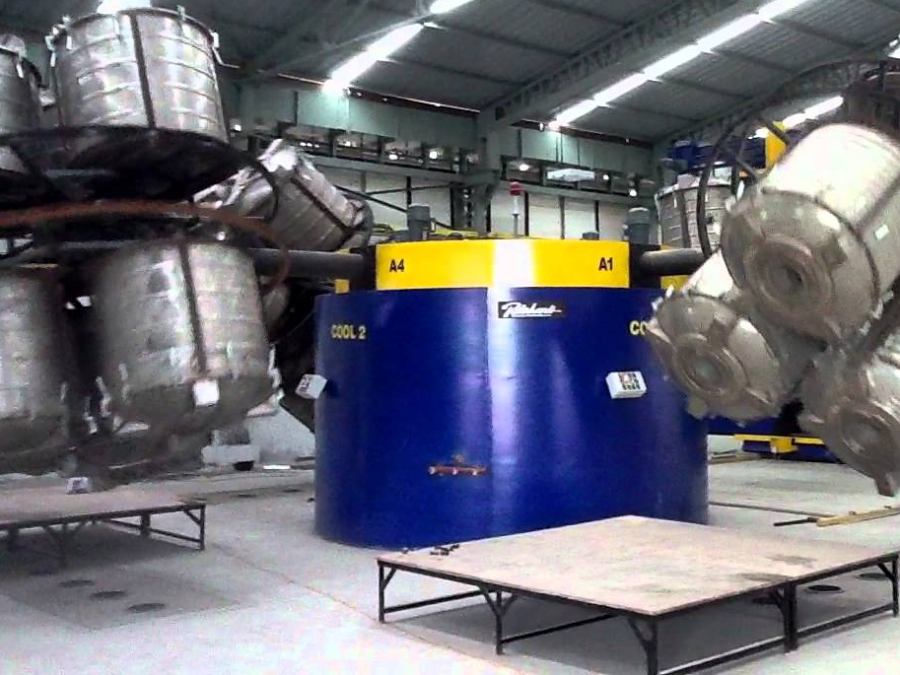
Rotational moulding
This method can be used to create medium to large sized hollow components from plastic.
It involves melting plastic inside a closed mould which is rotated so that the softened plastic coats the inside of the mould.

Slide 29
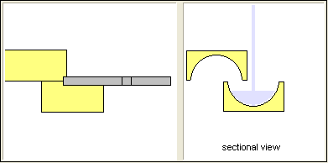
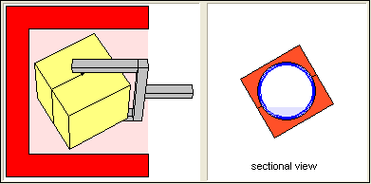
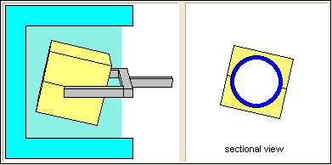
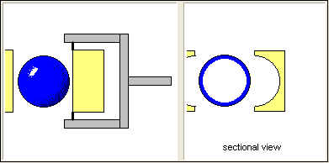
Rotational moulding
Stage 1 At this stage the liquid plastic is poured into the mould. The mould is then sealed and the process of rotating it begins.
Stage 2 This stage shows the plastic being heated as it is rotated around the mould. The heated plastic coats the inside wall of the mould.
Stage 3 The completed plastic mould is now cooled before ejection from the mould.
Stage 4 The moulded shape is ejected from the mould. The picture here shows a hollow sphere.

Slide 30
https://www.youtube.com/watch?v=q2xE-VfAjmE

Slide 31
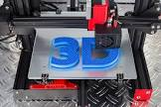
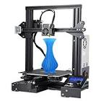
3D Printing
3D Printing is an “additive” manufacturing process, meaning that material is added to make a product.
Benefits-
Flexible Design
Rapid Prototyping
Print on demand
Strong and lightweight parts
Minimal waste
Batch production is possible
Can be cost effective
Ease of access
Drawbacks-
Limited materials
Restricted build size
Post processing (Removing excess material/scaffolding).
Large volumes aren’t possible/time efficient
Design inaccuracies
Copyright issues
Video-
https://www.bbc.co.uk/bitesize/clips/zkn9wty

Slide 32
task
Using the internet, research ONE of the processes we have just discussed, and create an A4 sheet that could be used to teach someone else about the process.
Things you need to find out about ONE process;
The process broken down into steps (with diagrams).
Identifying features of the process.
2-3 Products made using the process.
Some advantages and disadvantages of using plastic for these products instead of e.g. metal, wood etc.
Format
Create an A4 landscape page for your chosen process
Include diagrams, sketches and annotation to help explain your research.
Possible process-
Injection moulding
Vacuum forming
Rotational moulding
3D printing

